Slide 1
Hand gesture recogition

Slide 2
Two major approaches
With extra data
Pros:
Possibility to create a strong model able to work with different situations
Wider possible range of used gestures
Cons
Need for well-prepared data
Training time
Possible that inference may take much time (if model is big)
Without extra data
Pros:
No need to search for data and check its quality
Simple algorithms may be much faster than complicated networks
Cons
Possible limitations of detectable gestures
The models are likely to be more affected by environment (light e.g.)
More assumptions for the model

Slide 3
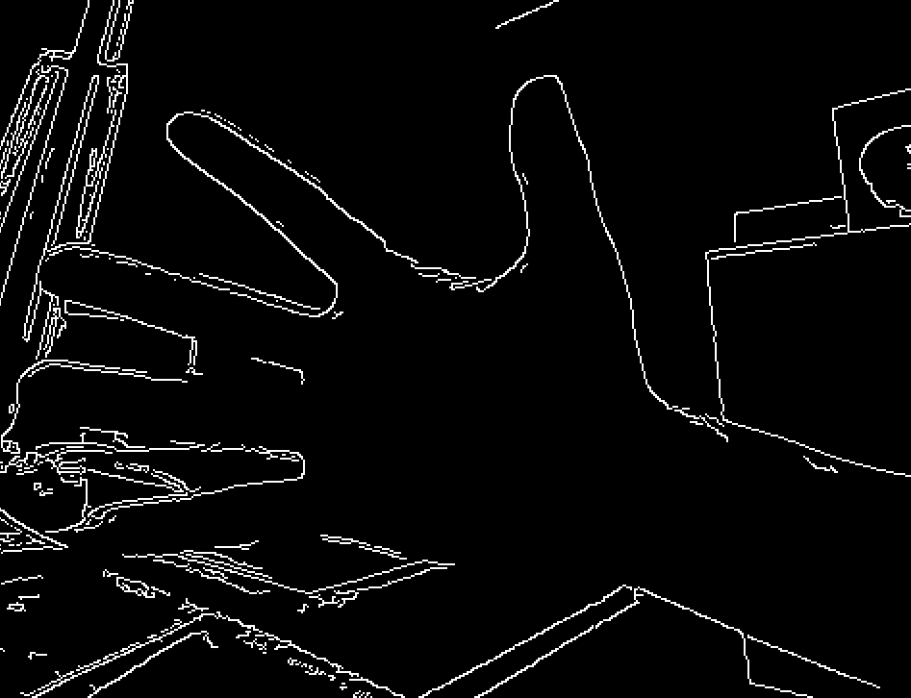


Hand detection approaches
Canny
Background substraction
Color-based approach

Slide 4
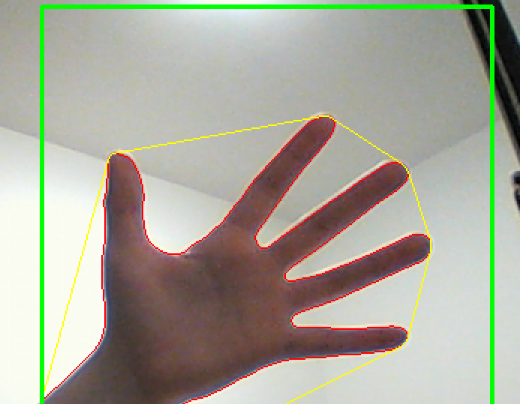
Gesture detection
Contour detection
Convex hull
Defects

Slide 5
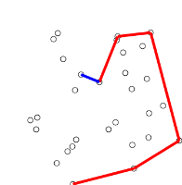
Convex hull - Graham scan
Select edge point
Sort other points based on polar angle with x-axis
Push one by one
Check if three last points fo counter-clockwise

Slide 6
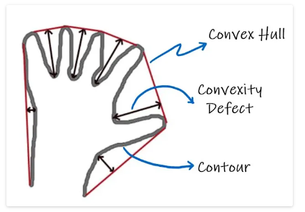
Convexity defects
Go through all points in the hull and check if there are points from the shape between them.

Slide 7
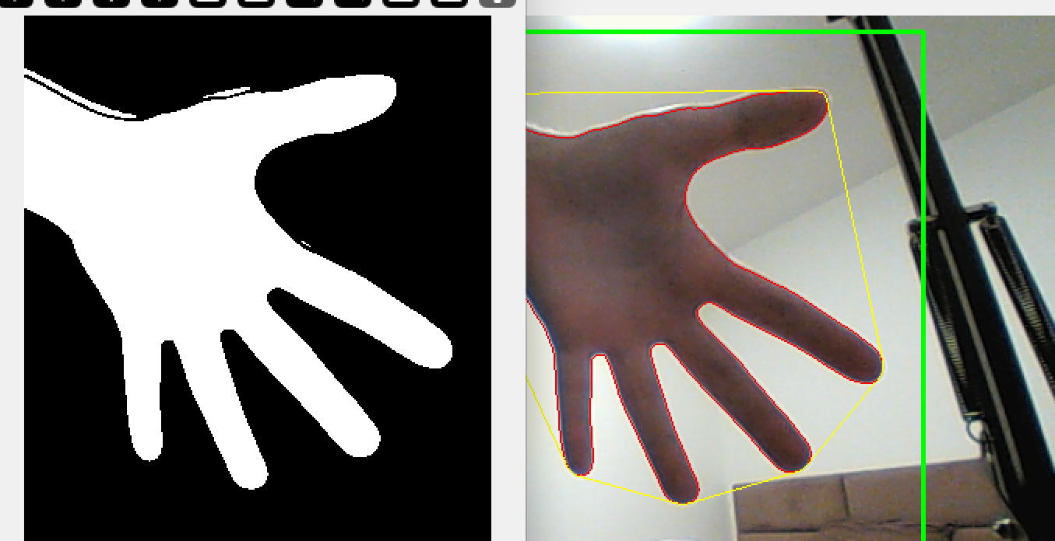
Results
Developed approach is quite fast and able to press certain keys on keyboard based on the gesture.
It is not able to recognize a wide range of gestures, however it is robust to different gesture positions, like rotation.

